Slide 1
Course Code: CSC211A Course Title: Formal Languages and Automata Theory
Lecture 31: Computing Functions with Turing Machines
Course Leader:
Prakash P
prakashp.cs.et@msruas.ac.in

Slide 2
Session Objectives
At the end of this session, student will be able to
Explain functions with Turing machine
Understand the role of Turing machine for solving functions

Slide 3
Session Topics
Functions with Turing Machines
The role of Turing machine for solving functions

Slide 4
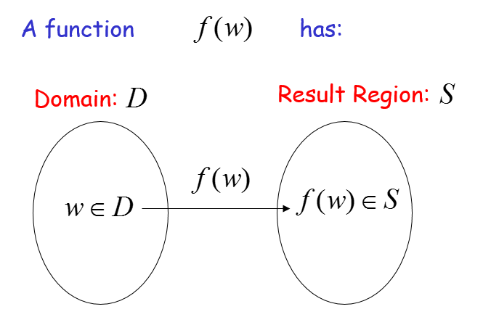
Functions with Turing Machines

Slide 5
Functions with Turing Machines
A function may have many parameters:
Example:
Addition function

Slide 6
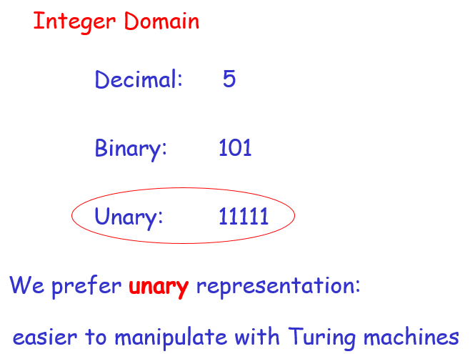
Functions with Turing Machines

Slide 7
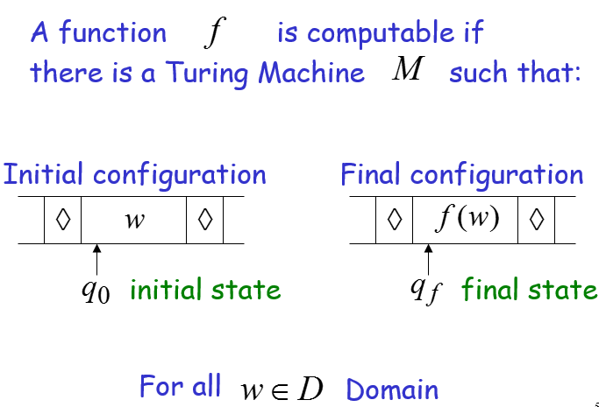
Definition

Slide 8
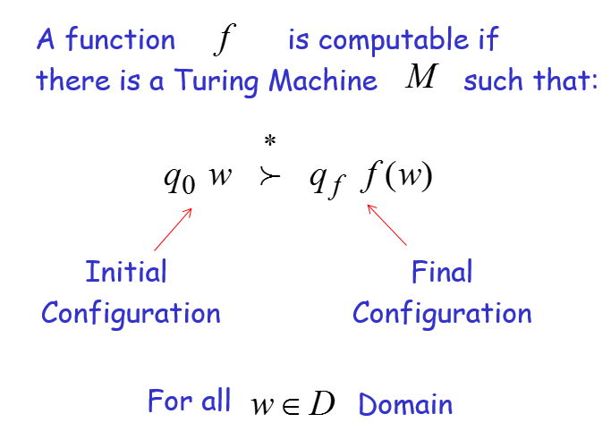
Functions with Turing Machines

Slide 9
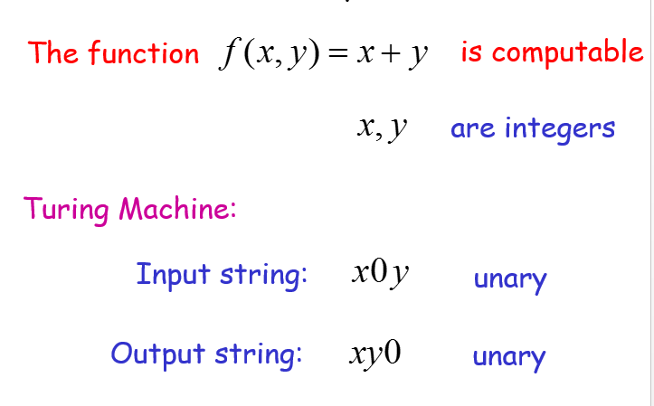
Example

Slide 10
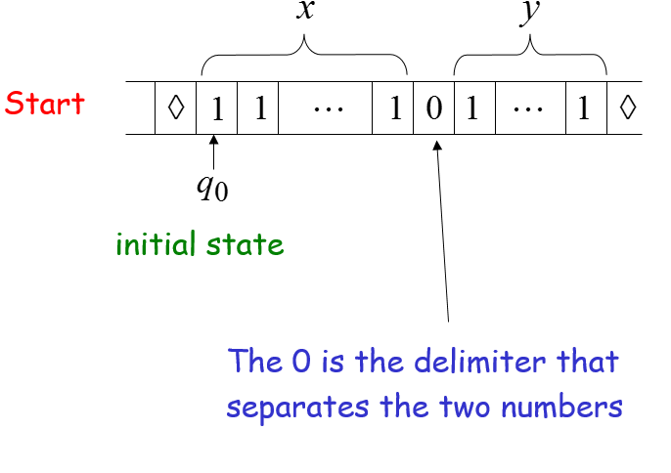
Example

Slide 11
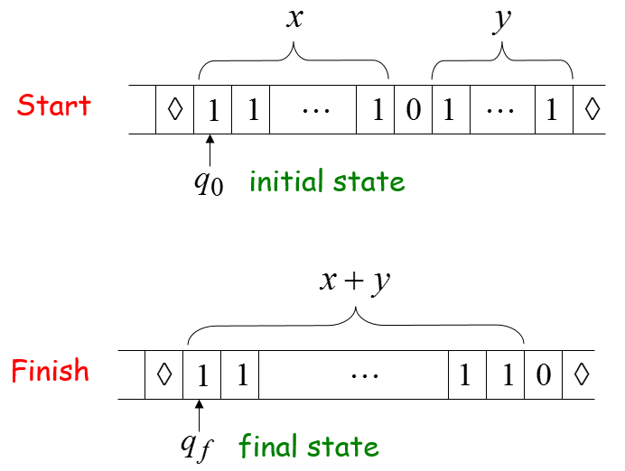
Example

Slide 12
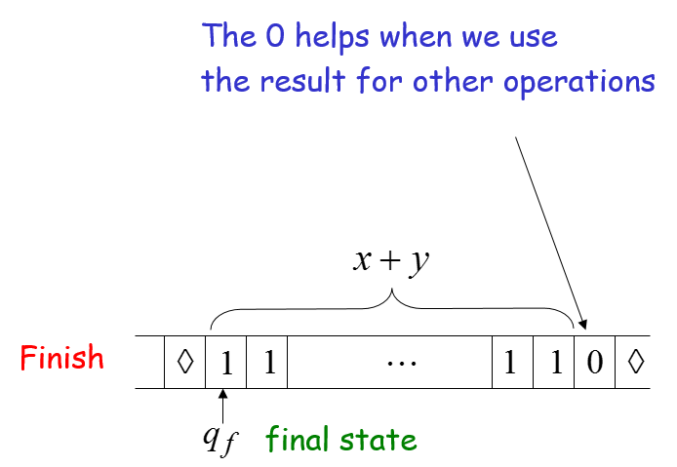
Example

Slide 13
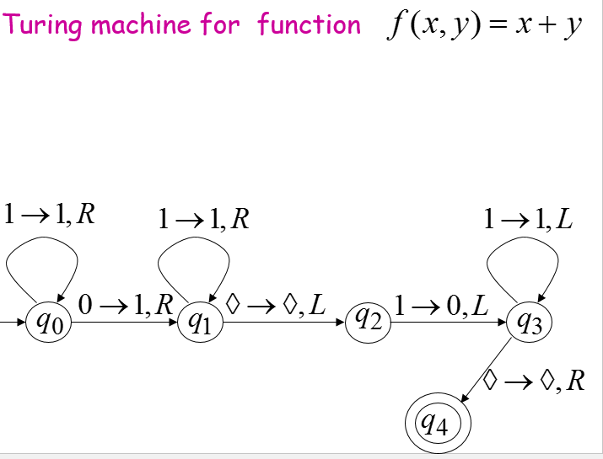
Turing Machine for Function

Slide 14
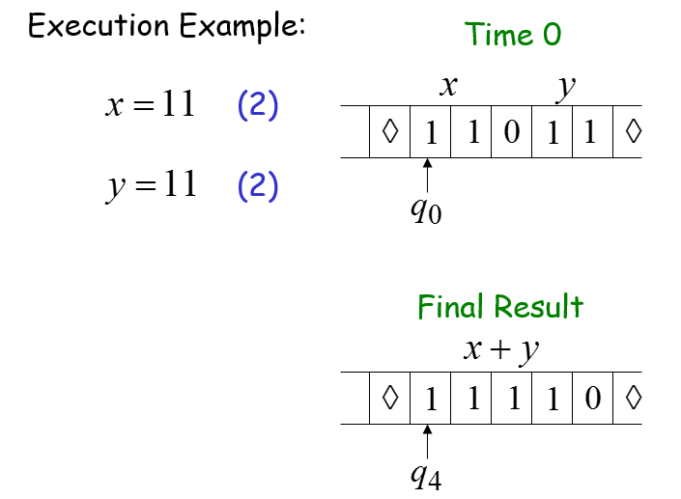
Turing Machine for Function

Slide 15
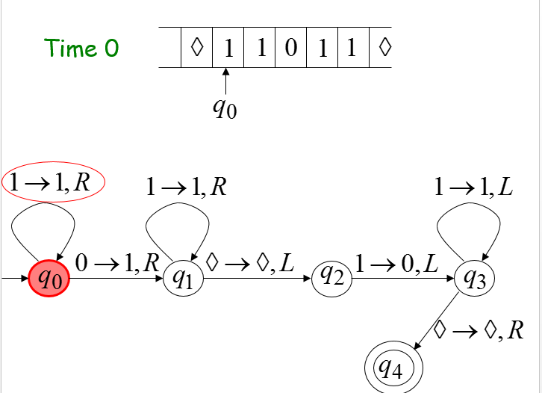
Turing Machine for Function

Slide 16
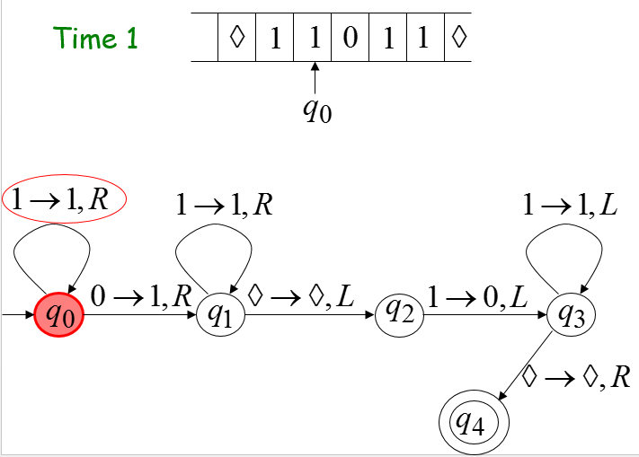
Turing Machine for Function

Slide 17
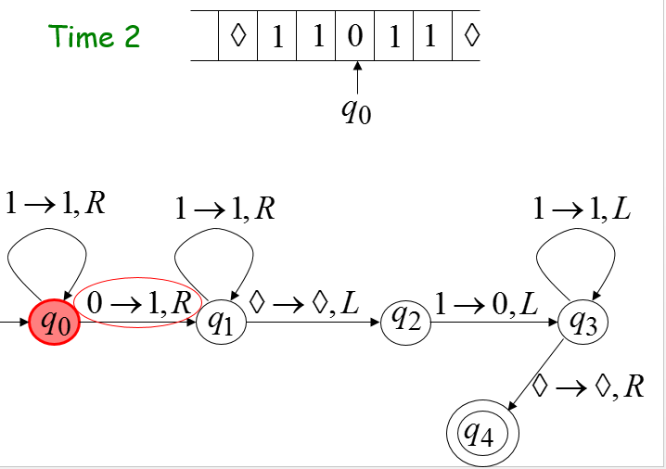
Turing Machine for Function

Slide 18
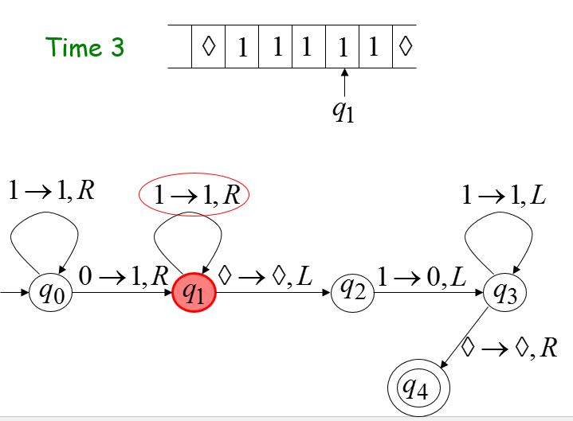
Turing Machine for Function

Slide 19

Turing Machine for Function

Slide 20
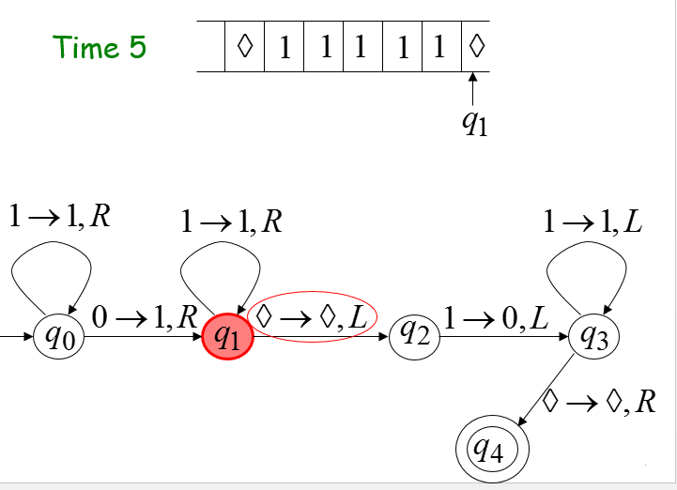
Turing Machine for Function

Slide 21
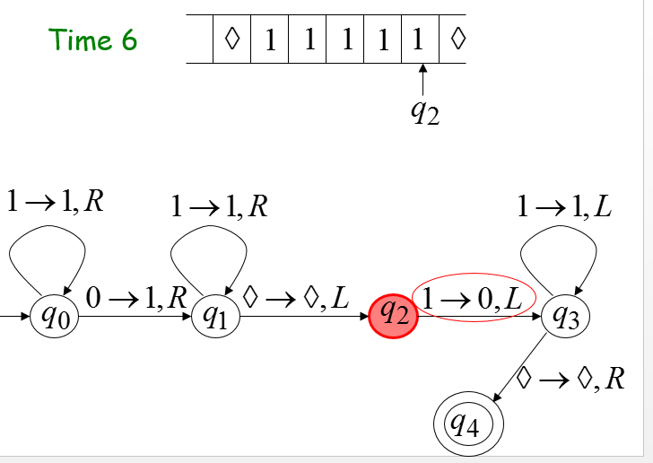
Turing Machine for Function

Slide 22
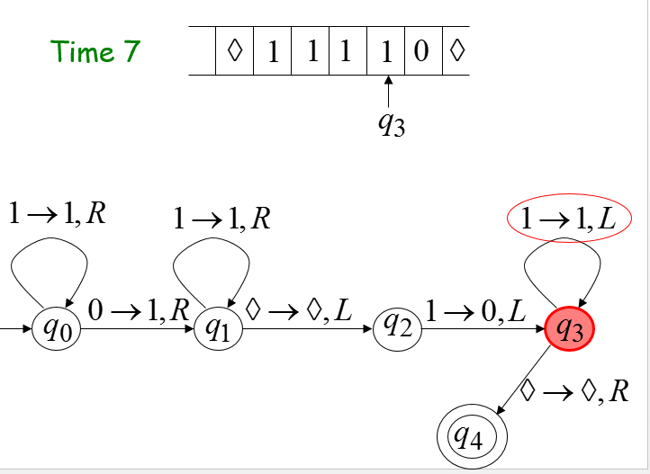
Turing Machine for Function

Slide 23
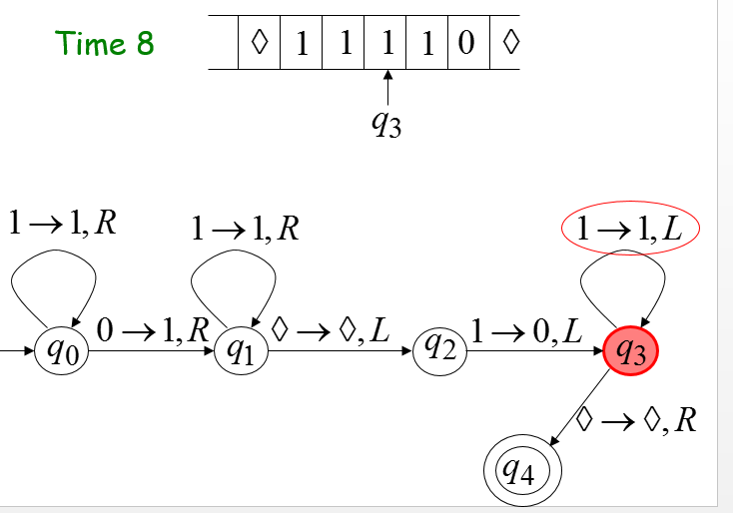
Turing Machine for Function

Slide 24
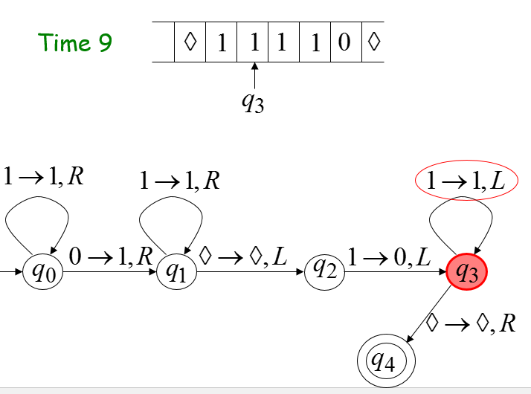
Turing Machine for Function

Slide 25
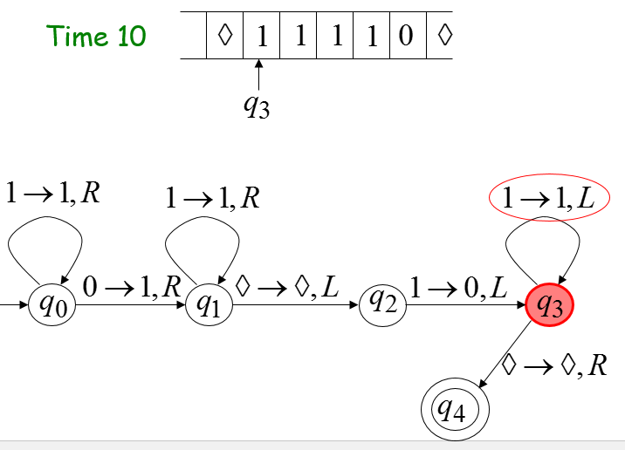
Turing Machine for Function

Slide 26
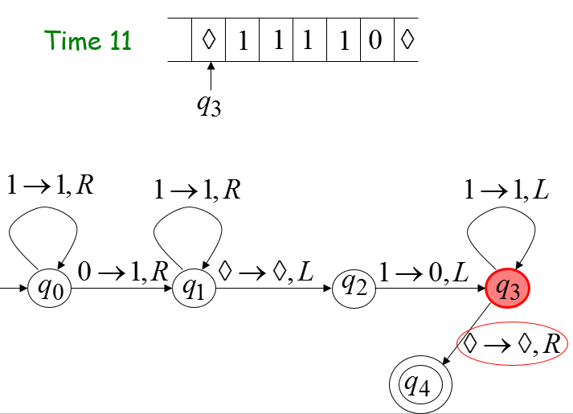
Turing Machine for Function

Slide 27
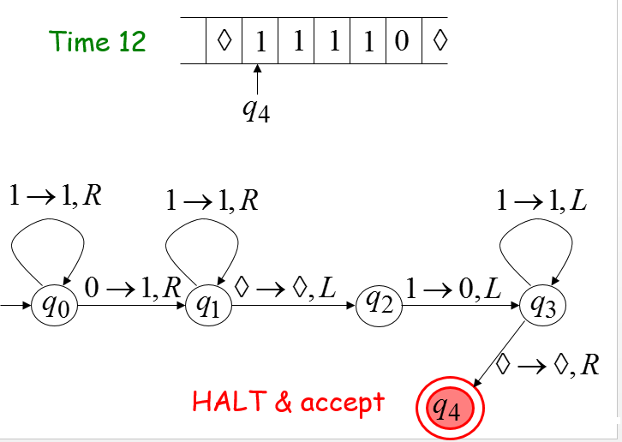
Turing Machine for Function

Slide 28
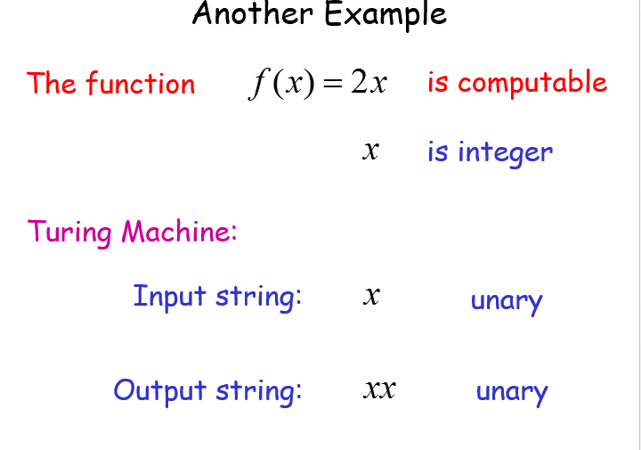
Another Example

Slide 29
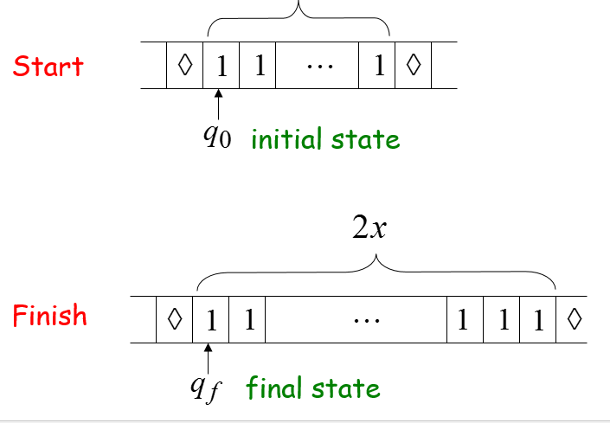
Turing Machine for Function

Slide 30
Turing Machine for Function
Turing Machine Pseudocode for
Replace every 1 with $
Repeat:
Find rightmost $, replace it with 1
Go to right end, insert 1
Until no more $ remain

Slide 31
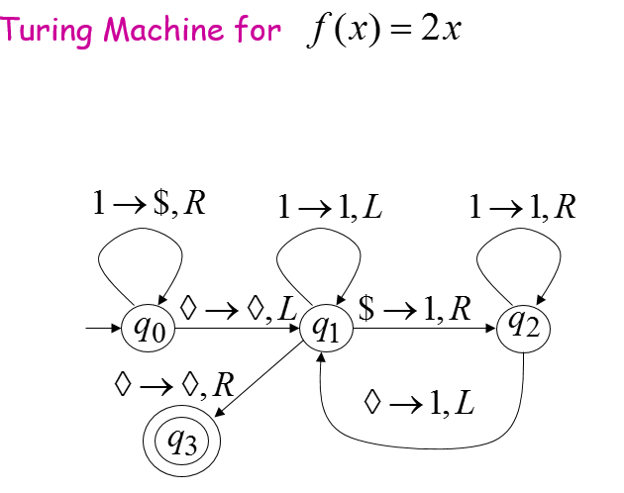
Turing Machine for Function

Slide 32
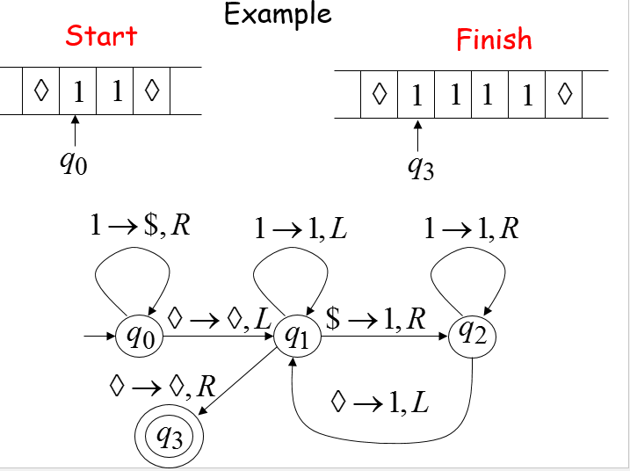
Turing Machine for Function

Slide 33
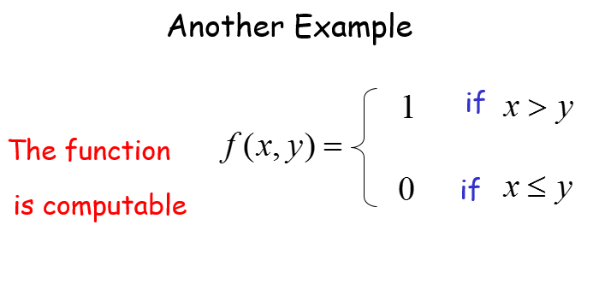
Another Example

Slide 34
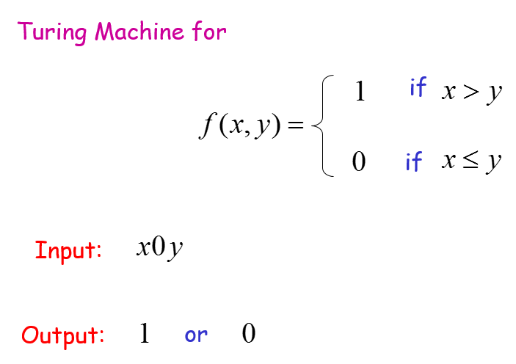
Turing Machine for Function

Slide 35
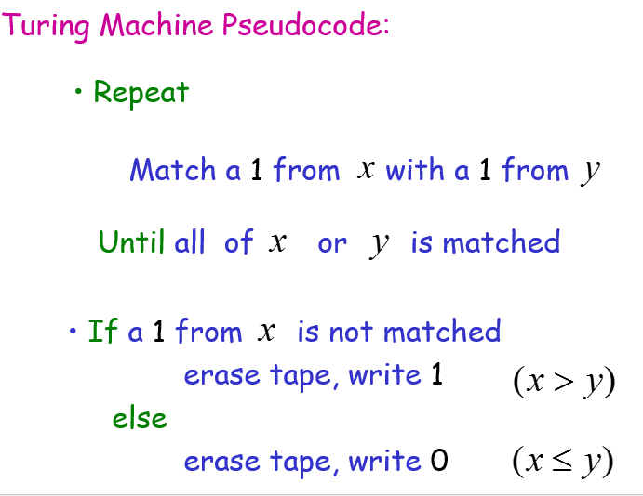
Turing Machine Pseudocode

Slide 36
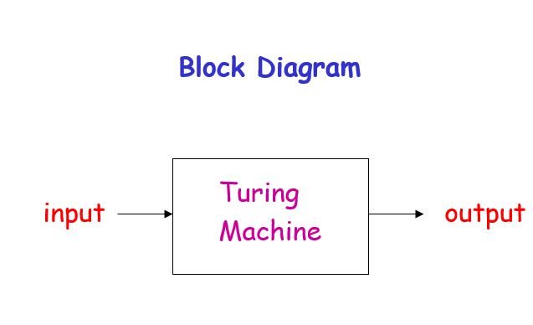
Turing Machine

Slide 37
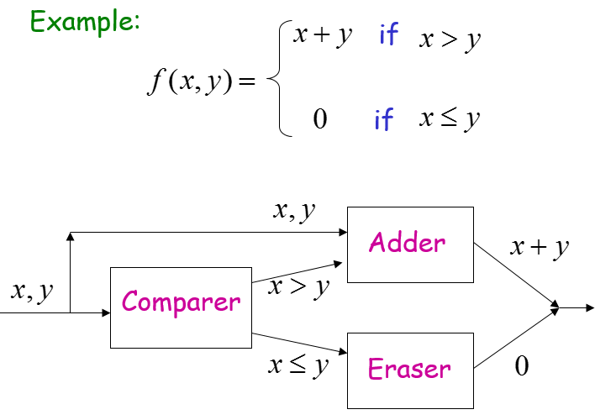
Turing Machine

Slide 38
Turing’s Thesis

Slide 39
Turing Machine
Question:
Do Turing machines have the same power with a digital computer?
Intuitive answer: Yes
There is no formal answer!!!

Slide 40
Turing’s Thesis
Turing’s thesis:
Any computation carried out by mechanical means can be performed by a Turing Machine
(1930)

Slide 41
Turing Machine
Computer Science Law:
A computation is mechanical if and only if it can be performed by a Turing Machine
There is no known model of computation more powerful than Turing Machines

Slide 42
Definition of Algorithm
An algorithm for function
is a
Turing Machine which computes

Slide 43
Algorithms are Turing Machines
When we say:
There exists an algorithm
We mean:
There exists a Turing Machine that executes the algorithm

Slide 44
Summary
Turing machines have the same power with a digital computer
Any computation carried out by mechanical means can be performed by a Turing Machine
A computation is mechanical if and only if it can be performed by a Turing Machine

